Slide 1

IMPACT OF NATIONAL INCOME ON LIFE EXPECTANCY
By Silatchom Nyoumssi Junior Alphonse
Statistical software used : Stata

Slide 2
MOTIVATION
Since 1800, lifespans have doubled again, largely due to improvements in environment, food and medicine that minimized mortality at earlier ages
It is common knowledge the link between wealth and life expectancy is positive , through out the years countries have been developing and increasing their life expectancy , which leads us to the question what impact does a country’s wealth have on its population life expectancy.

Slide 3
Moreover , life expectancy tends to be higher in countries with high income per capita and lower in countries with low income per capita. Why is that?
“The relationship between income and mortality is well established but remains poorly understood”. [Kaj Chetty and Michael Stepper (2001-2014)]

Slide 4
Graph of Income per capita vs life expectancy in South-eastern Africa

Slide 5
Graph of Income per capita vs life expectancy in North America

Slide 6
Design and Setting
Data on 266 countries from 1960 to 2021 each:
Life Expectancy
GDP per capita
Education spending by Government as percentage of GDP
Population growth rate
Health expenditure as a percentage of GDP

Slide 7
RELATED LITERATURE
The association between Income and Life Expectancy in the United States,(2001-2014) , by Raj Chetty, Michael Stepner,Sarah Abraham, Shelby Lin,Benjamin Swderi,Nicolas Turner, Augustus Bergeron, and David Cutler.
Results : -Higher income was associated with greater longevity
throughout the income distribution.

Slide 8
A Cross-Country Analysis of the Relationship Between National Income and Life Expectancy by Patrick Taylor (April 30,2021 )
Results : -National Income is positively correlated to Life
expectancy

Slide 9
ROAD MAP
Defining Life Expectancy
Data Construction and empirical Strategy
Analysis
Conclusion

Slide 10
What is life expectancy
Life expectancy is a statistical measure of the average time an organism is expected to live, based on the year of its birth, current age, and other demographic factors like sex. The most commonly used measure is life expectancy at birth (LEB).
In this research we are making use of life expectancy at birth.

Slide 11
Data Construction and empirical strategy
We will use GDP per capita as a measure of an economy’s national income in this regression.
The variables mentioned previously will serve as observable control covariates, as they are correlated with the GDP per capita. They were all obtained from the World Bank database.

Slide 12
The method used to answer this question is Panel data regression by Fixed effects model . The reason is because firstly my data looks like panels, we have each Country which serves as a cross - section and we have about 61 years (from 1960-2021) under each cross section. Which suggests a strongly balanced panel .

Slide 13
Each country is so very different and there are so many other unobserved variables that are country specific and do no change overtime that are correlated with the independent variable GDP per capita which I can not account for, which thereby forms the fixed effect of my regression correlated with the independent variable and uncorrelated with the error term. The Fixed effect model will help me get rid of these and obtain a causal effect.

Slide 14
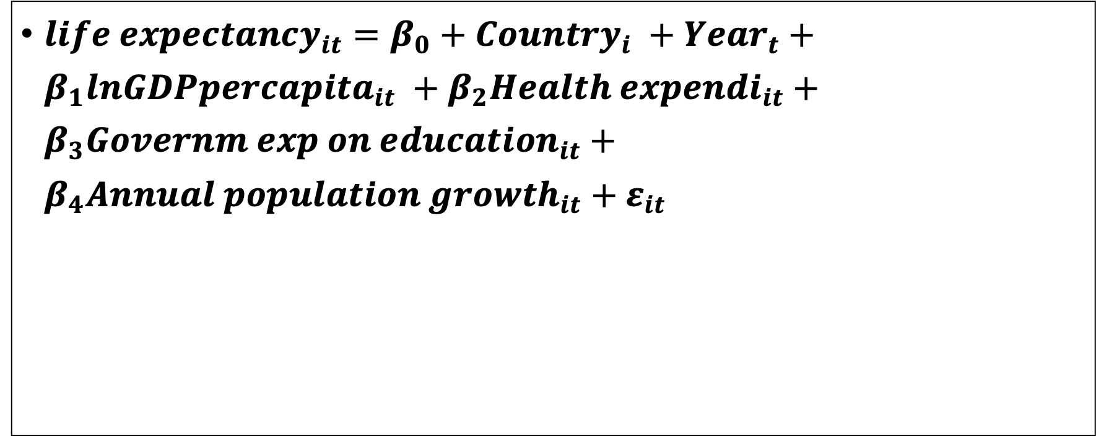
Equation
${life expectancy}_{it}=β_{0}+{Country}_{i} +{Year}_{t}+β_{1}{lnGDPpercapita}_{it} +β_{2}{Health expendi}_{it}+β_{3}{Governm exp on education}_{it}+β_{4}{Annual population growth}_{it}+ε_{it}$

Slide 15
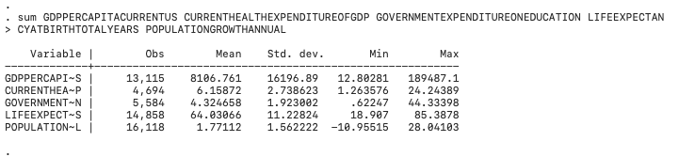
SUMMARY OF VARIABLES
A total of 16492 observations as a whole

Slide 16
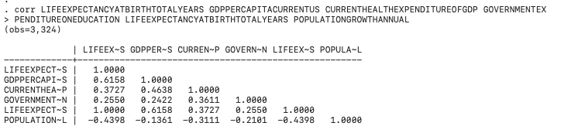
Correlation of regressors

Slide 17
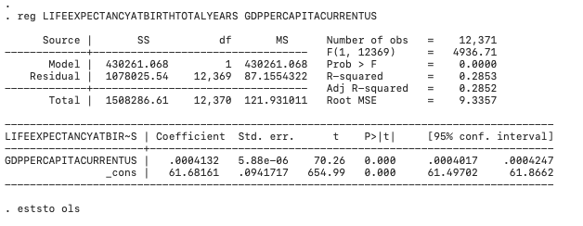
First regression OLS

Slide 18
Description
GDP per capita has a 0.4% impact on Life expectancy at birth which is significant at the 5% level but the regression only explains about 28.53 percent of the total variability which is not that good

Slide 19
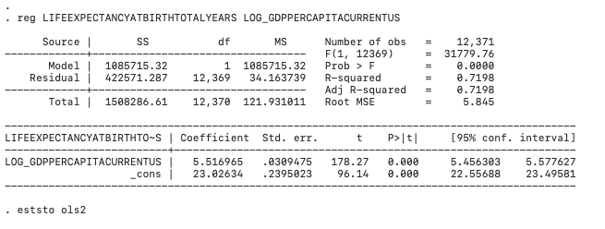
Second OLS regression : with only Log GDP PER CAPITA

Slide 20
Description of regression result
LOG_GDPPERCAPITACURRENTUS has a positive impact on life expectancy of about 5.51 which is significant at 5% level , more importantly the regression explains about 72% of the total variability which is good and the standard error is very low at about 0.0309475

Slide 21
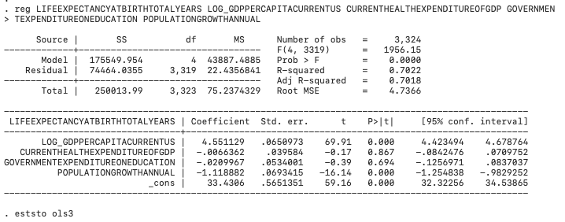
Third regression: Introduction of other covariates

Slide 22
Population growth has a significant negative impact in my model on life expectancy at the 5% level of about -1.12, R squared is high at about 70% which is good , health expenditure and education expenditure both affect life expectancy negatively in my model and they are not significant at the 5% nor the 10% level

Slide 23
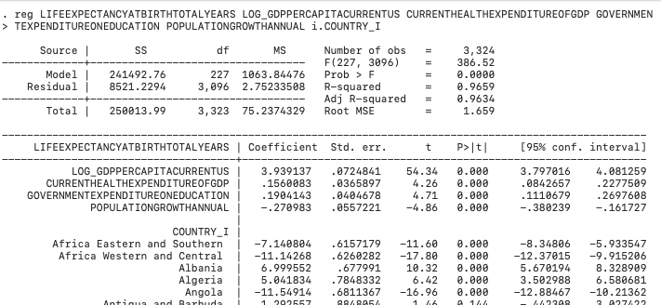
4TH REGRESSION : The base for comparison in this regression is Afghanistan

Slide 24
In this model we see that the coefficient of determination was boosted to 96.69% which is very good as it is close to a hundred, meaning the model explains close to 100% of the total variability,.
We see that all the variables prior to the use of the categorical variable COUNTRY_I are now significant at the 5% significance level, every variable other than population growth have a positive impact on life expectancy which goes in line with our intuition as compared to the previous models which have spending on health by government showing a negative coefficient which goes against our intuition.
The base for comparison in the COUNTRY_I categorical variable is Afghanistan so each country is being compared to Afghanistan in the regression .
The standard errors are very low and there are 3324 observations as in the previous models.

Slide 25
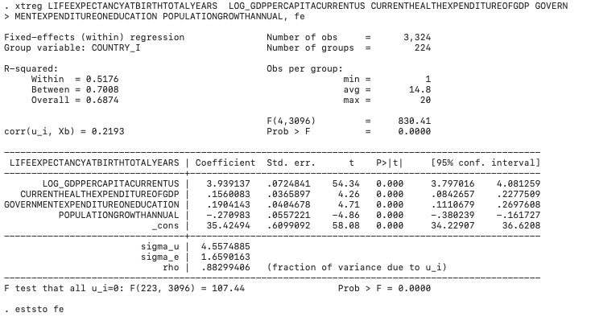
FIXED EFFECT REGRESSION :Identical coefficients to the previous regression with Country as categorical variable

Slide 26
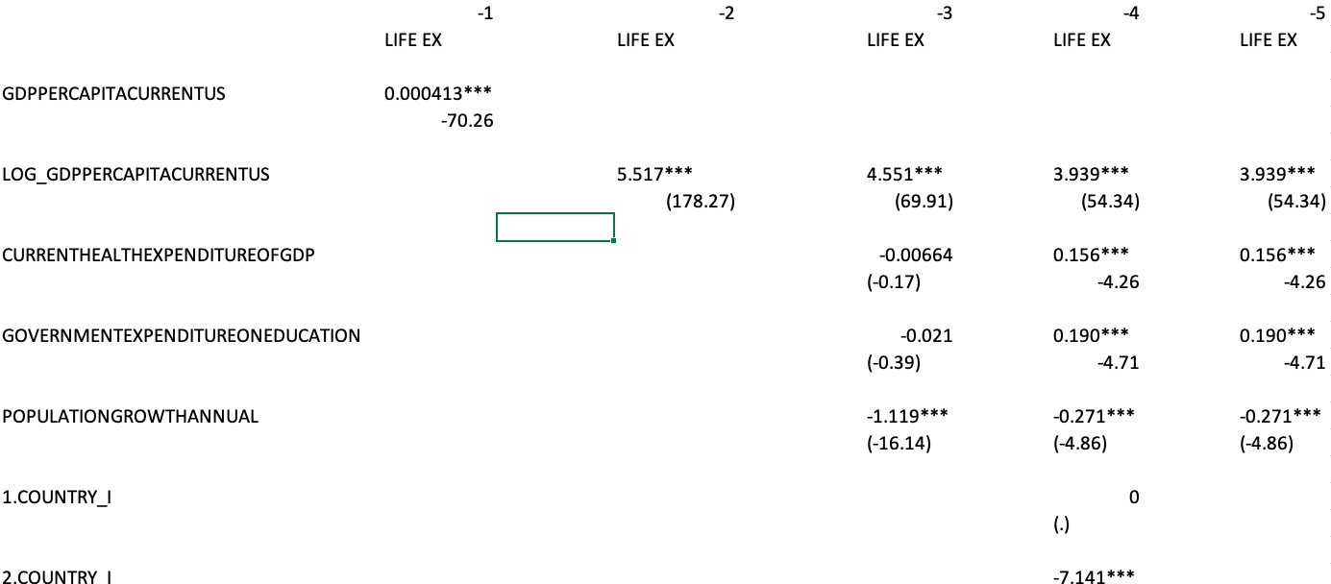
TABLE RESULTS FOR EACH METHOD USED ACCORDINGLY

Slide 27
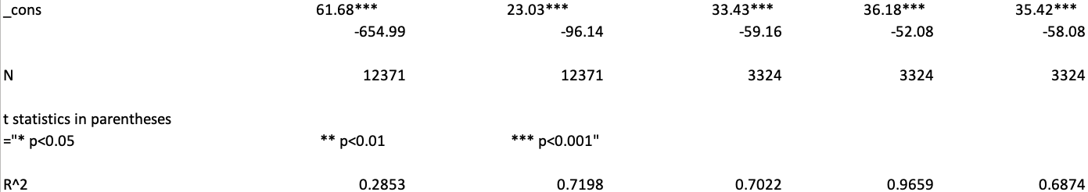

Slide 28
Comparison
As means of comparison I will use Patrick Taylor’s results on this research, he used an OLS to identify the causal effect of national income on life expectancy , with 250 countries and the same control variable as me, I entirely inspired myself from his research. For the independent variable log GDP per capita the result is a significant positive coefficient of about 9.62 and a strong R^2 of about 82%. Also, he has higher standard errors than me for each variable, and 2 of his variables have a significant effect meanwhile all my variables are significant. Surely due to the fact that I used a different model than him.

Slide 29
DESCRIPTIVE GRAPHS OF GDP PER CAPITA VS LIFE EXPECTANCY FOR ALL COUNTRIES TOGETHER

Slide 30
SCATTER PLOT FOR BELGIUM, LIFE EXPECTANCY VS GDP PER CAPITA
We can see
A clear Positive correl-
ation between Life ex-
pectancy and GDP per
capita

Slide 31
SCATTER PLOT FOR BURKINA FASO, LIFE EXPECTANCY VS GDP PER CAPITA
We can see
A clear Positive correl-
Ation between Life ex-
pectancy and GDP per
capita

Slide 32
Conclusion
It can be concluded that the national income has a positive effect on life expectancy. They are positively correlated

Slide 33
Data Sources
“Current health expenditure (% of GDP).” The World Bank, data.worldbank.org/indicator/SH.XPD.CHEX.GD.ZS
https://data.worldbank.org/indicator/SH.XPD.CHEX.GD.ZS
“GDP per capita (Current US$).” The World Bank, data.worldbank.org/indicator/NY.GDP.PCAP.CD
https://data.worldbank.org/indicator/NY.GDP.PCAP.CD
“Government Expenditure on Education, Total (% of GDP).” The World Bank, data.worldbank.org/indicator/SE.XPD.TOTL.GD.ZS
https://data.worldbank.org/indicator/SE.XPD.TOTL.GD.ZS

Slide 34
Data Sources
“Life Expectancy at Birth, Total (Years).” The World Bank, data.worldbank.org/indicator/SP.DYN.LE00.IN
https://data.worldbank.org/indicator/SP.DYN.LE00.IN
“Population growth (annual %).” The World Bank, data.worldbank.org/indicator/SP.POP.GROW
https://data.worldbank.org/indicator/SP.POP.GROW

Slide 35
References
Roser, Max, et al. “Life Expectancy.” Our World in Data, 23 May 2013, ourworldindata.org/life-expectancy
Taylor ,Patrick (2021) A Cross-Country Analysis of the Relationship Between National Income and Life Expectancy , Georgia Institute of Technology

